Slide 1
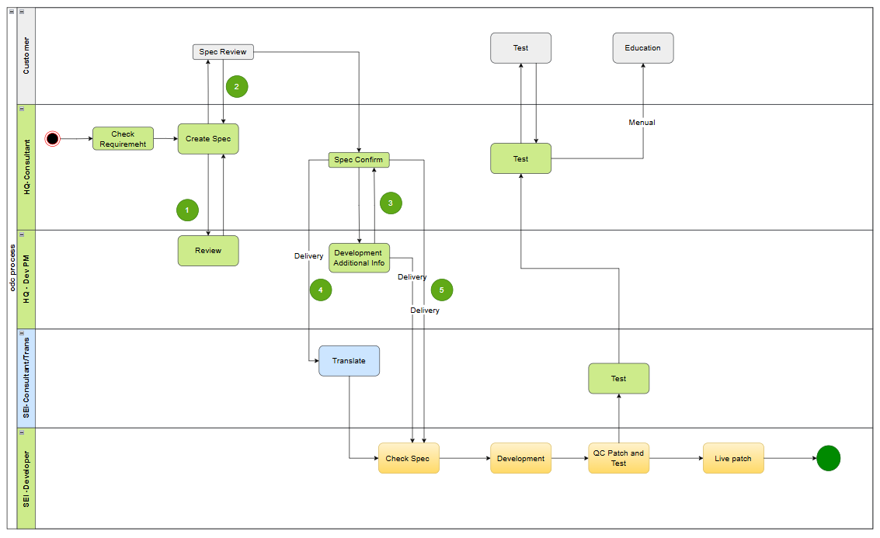


Customer
Contract
Development
Test
Education
Live
HandOver
Role PIC
ERP

